Slide 1
Speed-I
View from Material Side
Qing Peng, Anil U. Mane, Jeffrey W. Elam
Energy Systems Division
Argonne National Laboratory
Limitations on Fast Timing Workshop at U of Chicago

Slide 2
Components Contribute to Timing of MCP detector
V₃
Anode
V₄
V₂
Photocathode
V₅
V₁
t₅
t₃
t₄
t₂
t₁
Microchannel plate
Rev. Sci. Instrum. 81, 073112 (2010)

Slide 3
Transition Time Spread AND Transition Time
m: Electron Mass
v₀: Initial speed of electron
v: Final speed of electron
∆V: Voltage different between collision
e
ν_{ι}
ν_{v}
L
Transition time
D
Rise time and Transition time spread
related to spread of Vι
Nuclear instruments and methods, 162 (1979), 587-601.

Slide 4
What determines timing?
The Transition time spread
  Proportional to L, for given L/D and voltage
  Proportional to transition time, for given L/D and voltage
  Smaller D, Smaller FWHM
  Smaller distribution of V_{ι},(smooth wall surface of MCP), Smaller FWHM
The transition time
  Proportional to channel length (L)
  Space charge saturation set a standard L
  Well defined repeatable the transition time
So Timing is a strong function of channel length, given
L/D and potential and other parameters fixed Operated in saturation range
e
ν_{ι}
ν_{v}
L
D
Nuclear instruments and methods, 162 (1979), 587-601.

Slide 5
What determines the Length of MCP for operating in saturation region
L/D of MCP for saturated gain: 40-60
L is determined by D
Smaller D, Smaller L, faster timing
D has been reported down to 2μm
G: gain
α: Length to diameter ratio
α_{m}: L/D when Gain is saturated, normally
α_{m} ~ 40-60
V: Total channel voltage
A: constant
V₀: initial energy of an emitted 2nd electron
(~1eV)
Nuclear instruments and methods, 162 (1979), 587-601.
S. Tremsina etc, Proc. SPIE, vol. 4854
B. N. Laprade etc, Proc. SPIE 3173, pp. 474-485 (1997)

Slide 6
What determines the Length of MCP for operating in saturation region
Since Gain of MCP has upper limit (~10⁴) due to ion feedback and performance instabilities
Larger δ, will give smaller L
Smaller L, faster timing
G: Gain
δ (1) to δ (n): Secondary electron
Coefficient during 1 to n strike on channel
Nuclear instruments and methods, 162 (1979), 587-601.

Slide 7
Several Thoughts for Faster Timing from Material View
MCPs with smaller pore size
Engineering the Pore Entrance
Engineering the SEE material inside of pore
Decrease Ion feedback

Slide 8
Binary Reaction Sequence for Al₂O₃ ALD
CH₃
Trimethyl Aluminum
(TMA)
Al
CH₄
CH₃
CH₃
A)
CH₃
CH₃
CH₃
CH₃
Al
Al
Al(CH₃)₃
Al
CH₃
CH₃
OH
OH
OH
OH
OH
OH
H₂O
CH₄
H₂O
OH
OH
B)
CH₃
OH
CH₃
CH₃
CH₃
CH₃
Al
CH₃
CH₃
CH₃
Al
Al
H₂O
Al
CH₃
CH₃
Al
CH₃
Al
CH₃
OH
OH
OH
OH
OH
OH
1 ALD Cycle of TMA/H₂O Deposits 1 Al₂O₃ “Monolayer”
Courtesy from J. W. Elam
Notes:
8
Growth rate (“Monolayer” thickness) is governed by steric hindrance of ligands remaining on surface following metal precursor exposure

Slide 9
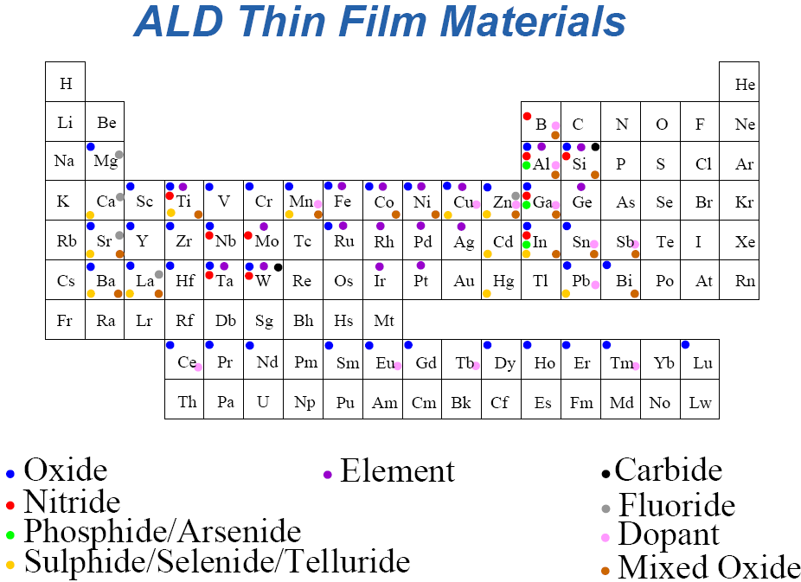
Courtesy from J. W. Elam
Notes:
9

Slide 10
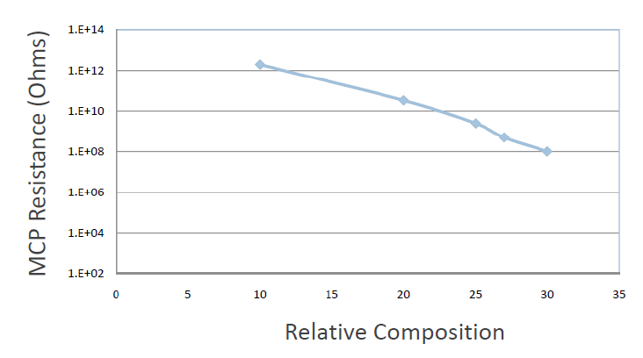
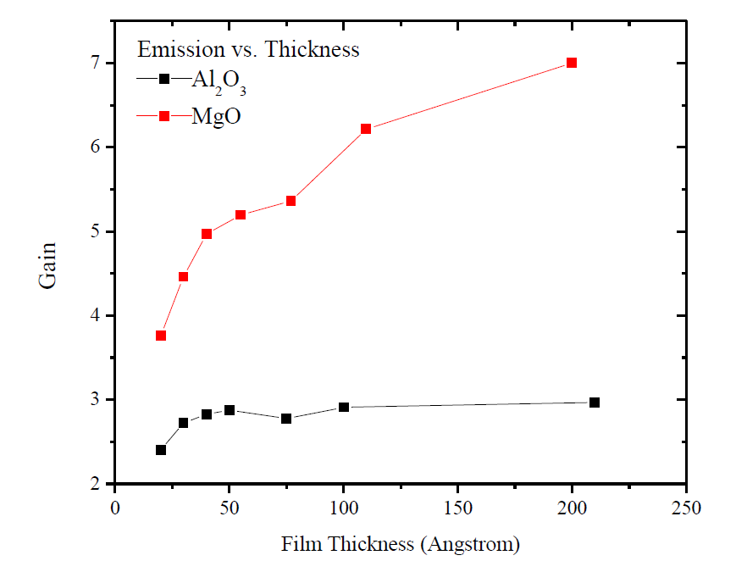
What ALD Capable of Engineering MCPs
Tuning resistivity of Materials
Tuning thickness of Materials
Tuning SEY coefficient of Materials
Courtesy from J. W. Elam
A. U. Mane, Slade J. Jokela

Slide 11
MCP with Pore Size from 6um to 1um
Atomic layer deposition is perfect for functionalizing channels with small pore size
pore
Resistive coating (ALD)
Emissive coating (ALD)
Conductive coating
(thermal evaporation)
S.M. George, Chem. Rev., 110, 111, 2011
J. W. Elam, Rev. Sci. Instru. Vol 73, 2981, 2002

Slide 12

Engineering 1st strikes Two Discrete Structure at the Pore Entrance
Electrode
End Spoiling
High SEE layer
by PVD
Resistive layer
MCP substrate
ALD SEE layer

Slide 13
How to control the depth of SEE into Pore by Physical vapor deposition
θ
The penetration depth depends on the θ
Bigger θ, Deeper the Penetration
The coating of High SEY layer tunable
θ
θ₁

Slide 14
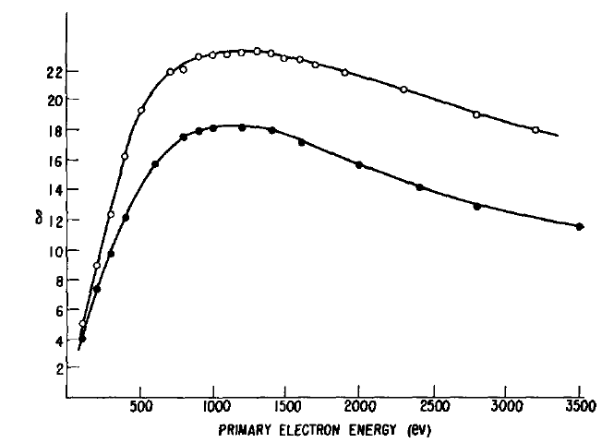
Candidate Materials for High SEE
Materials with Negative electron affinity, including activated GaP, GaN, GaAs, Diamond, and such. Trade off (more dark events)
Diamond coating (SEE: <80)
Highly crystallized MgO by PVD process (SEE:<25)
Single crystal MgO
MgO film

Slide 15
Engineering the SEE material inside of pore
High quality NaCl, CsI, MgF₂, CaF₂ (SEE 5-15)
ALD process exist for MgF₂ and CaF₂
ALD process can be developed for other candidate materials

Slide 16
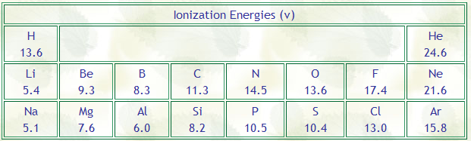
Decrease Ion Feedback of MCP
Ions produced inside of channel by electron collision between residue gas
Ion Energy of Gas Molecules
He adsorption on surface could alleviate the ion feedback problem.
Optimizing surface chemistry could decrease ion feedback.

Slide 17
Conclusions
Timing of MCPs could be improved by:
  MCPs with smaller pore size
  Engineering the Pore Entrance
  Engineering the SEE material inside of pore
  Decrease Ion Feedback Effect
Surface modification techniques including ALD and PVD could have great impact on those aspects

Slide 18
Supporting information
For L/D=60, V=1000kV,
  The existing electron has a median energy of 32.5 eV, an appreciate number of electron has energy >100eV
Ions produced inside of channel by electron collision between residue gas.
Nuclear instruments and methods, 162 (1979), 587-601.

Slide 19
Components Contribute to Timing of MCP detector
V₃
Anode
V₄
V₂
Photocathode
V₅
V₁
t₅
V_{app}: Voltage applied through MCP.
L: MCP length
M: Number of MCP in the assembly.
m , e: electron mass and charge
t₃
t₄
t₂
t₁
Microchannel plate
Rev. Sci. Instrum. 81, 073112 (2010)

